Slide 1

Live Class 1: Setup & First Steps

Slide 2

Hook – Welcome to Flutter World 🚀
Today → We set up your Flutter lab.
By end of class → You'll run your first app.

Slide 3
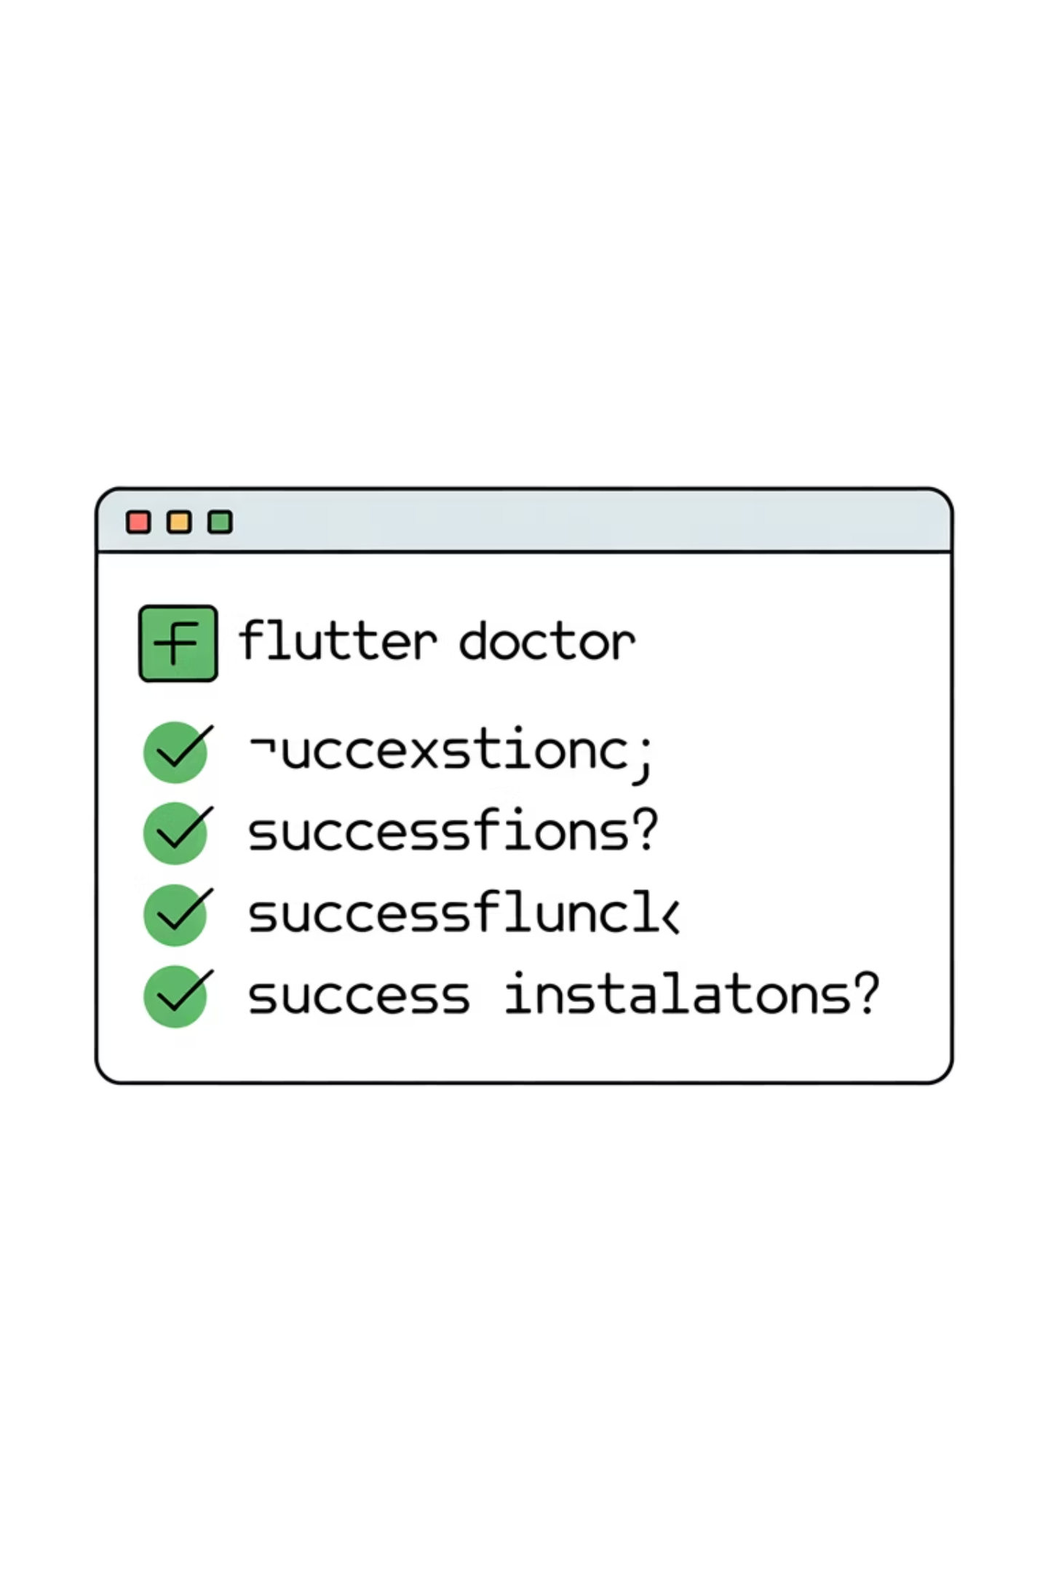
Install Flutter SDK
01
02
Download Flutter SDK (stable channel)
Add to PATH (so terminal can find Flutter)
03
Run flutter doctor → check everything

Slide 4
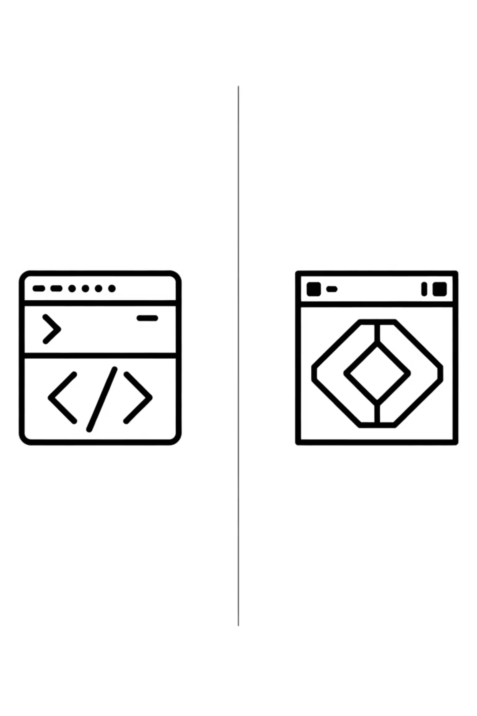

Setup IDE (VS Code/Android Studio)
VS Code Option
Install VS Code → lightweight, fast
Install Flutter & Dart extensions
Android Studio Option
OR Android Studio → heavier but full features
Personal tip: I use both — VS Code for speed, Studio for emulators.

Slide 5
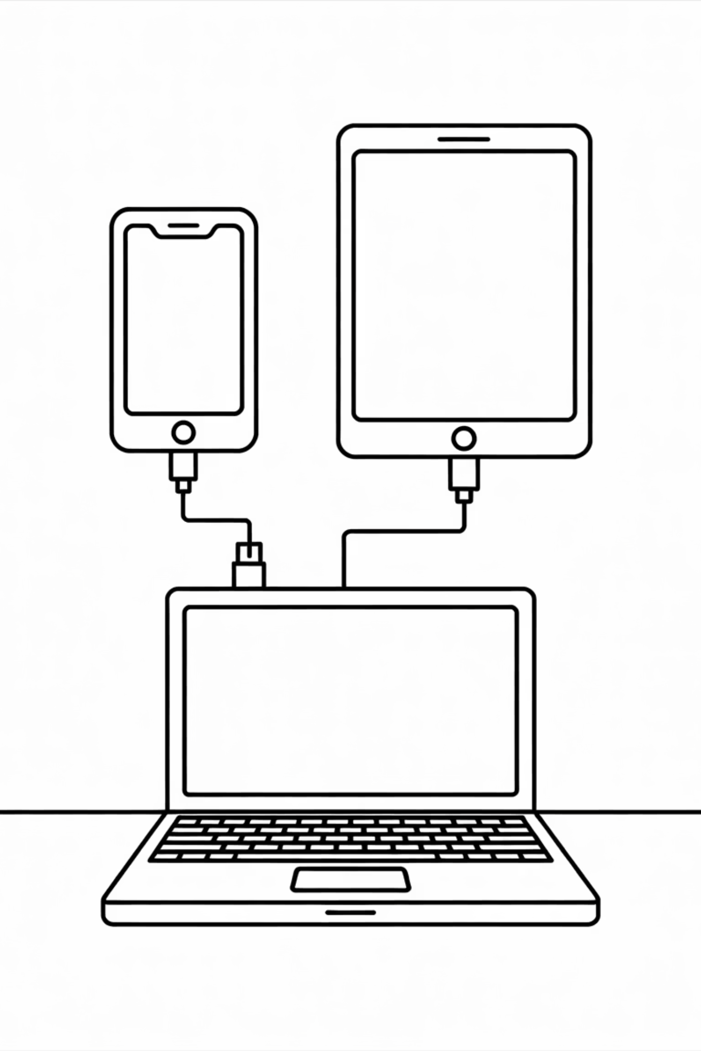
Setup Emulator / Physical Device
Android Emulator
iOS Simulator
Android Emulator → via Android Studio AVD Manager.
iOS Simulator → via Xcode (Mac only).
Physical Device
Physical device → Enable Developer Mode + USB Debugging.
Run flutter devices to check connected devices.

Slide 6
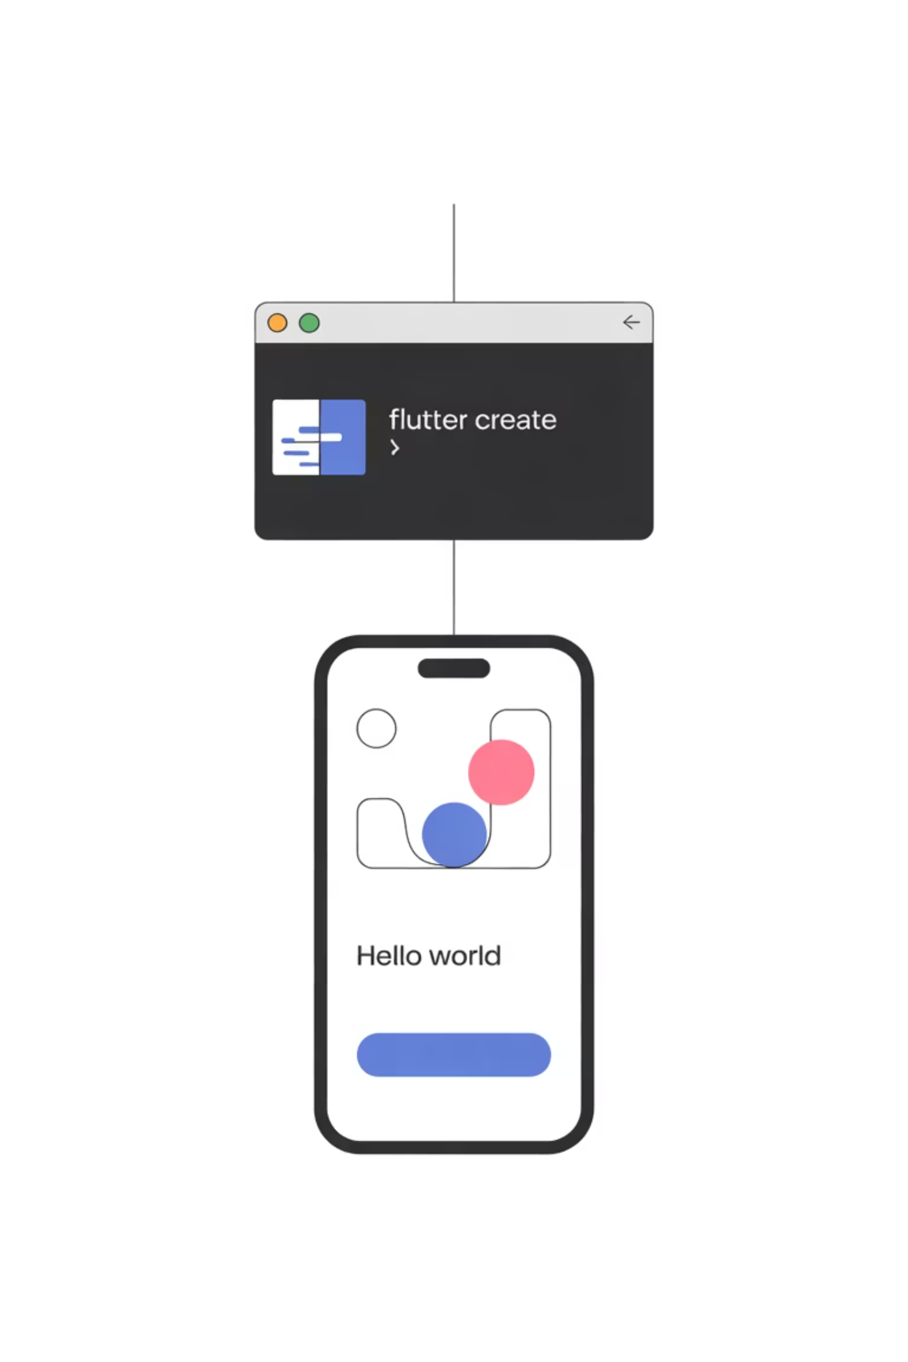



Create First Flutter Project
Command: flutter create my_app
Open in VS Code / Studio
Run: flutter run → Hello World on screen

Slide 7



Folder Structure Quick Look
lib/
pubspec.yaml
android/, ios/
lib/ → main code lives here.
pubspec.yaml → dependencies & assets.
android/, ios/ → platform-specific code.

Slide 8
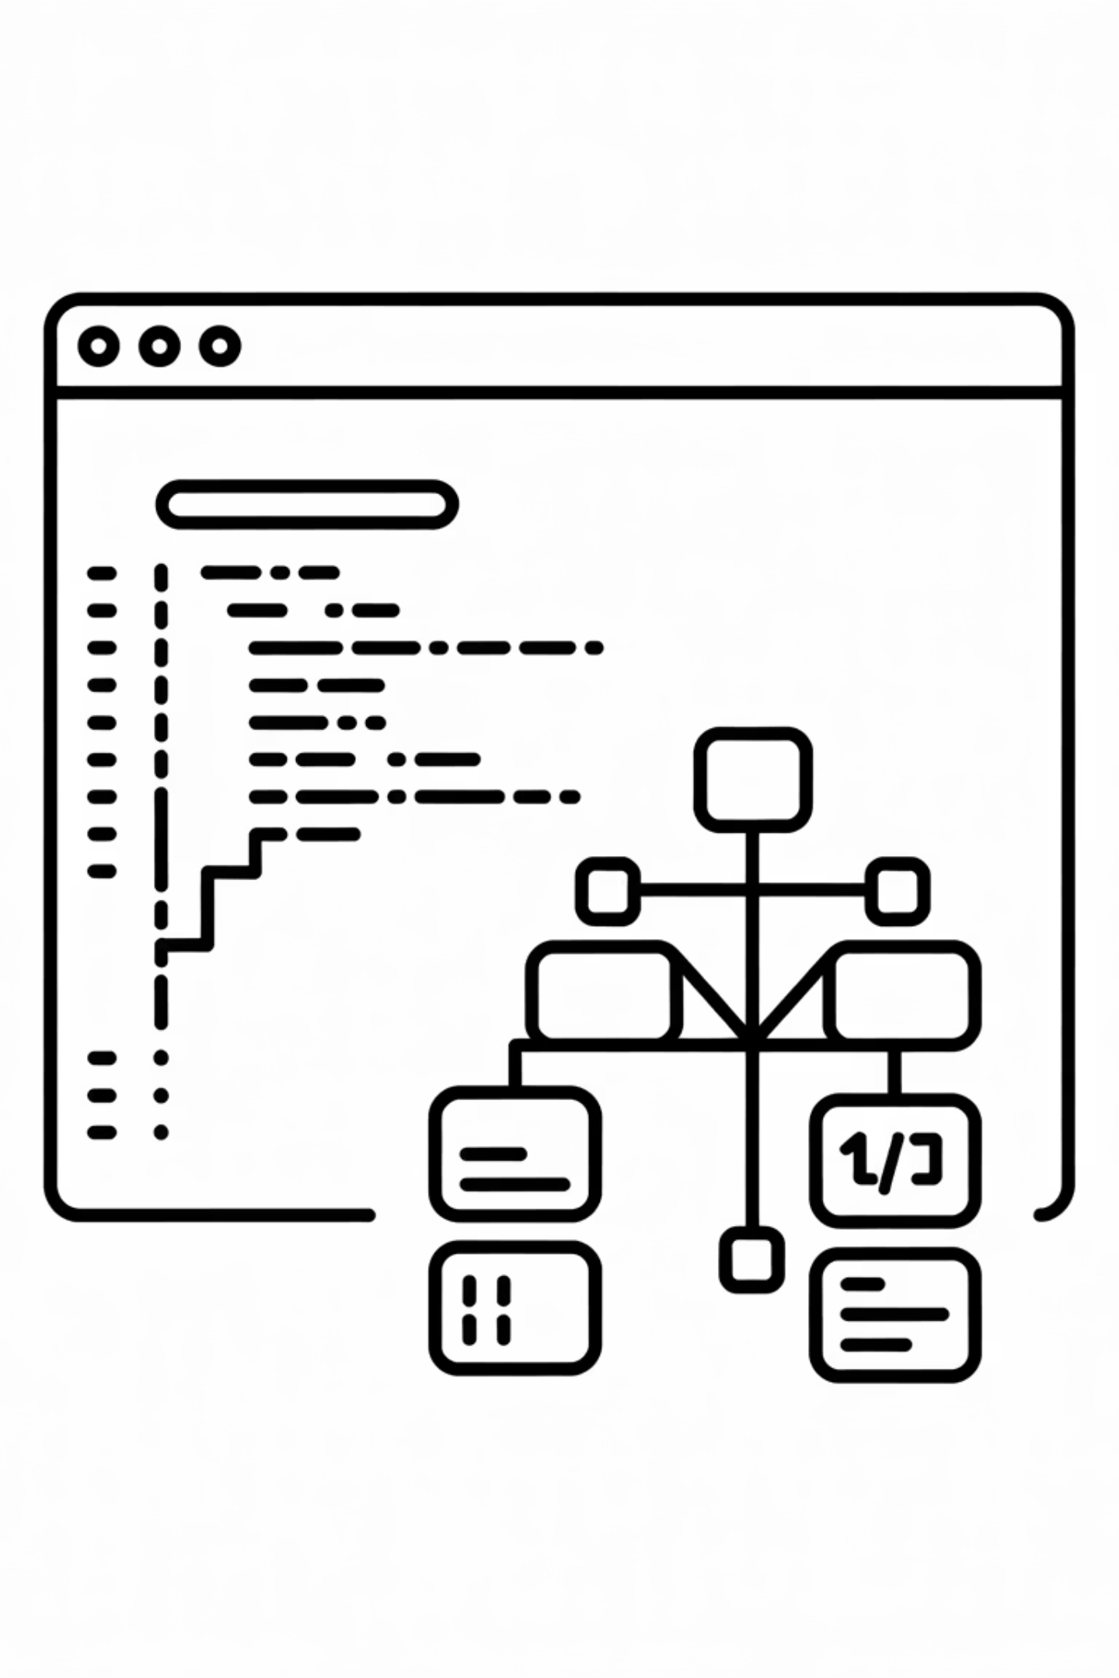
Dart Program Structure (main)
void main() { runApp(MyApp()); }
main() = entry point
runApp() = launches Flutter widget tree

Slide 9
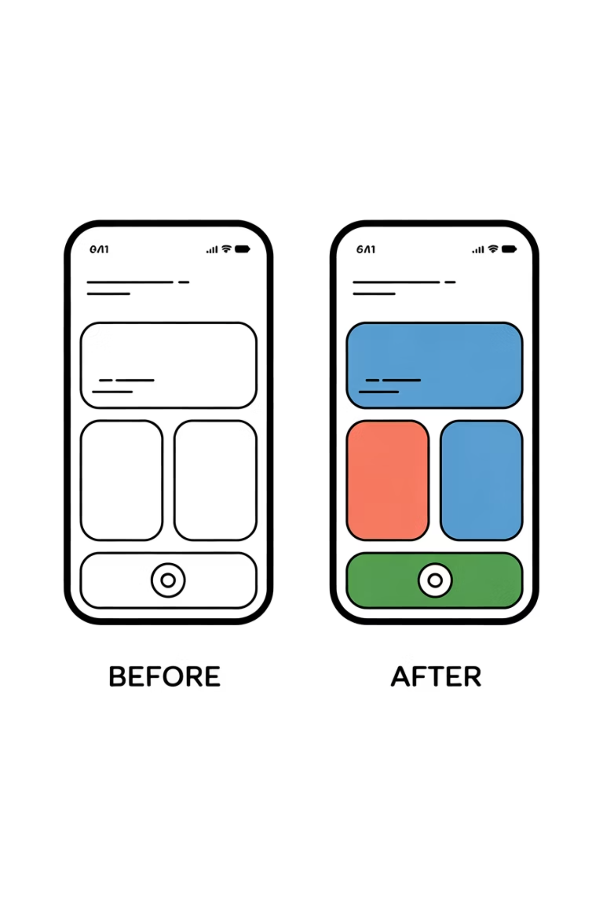
Modify Your First App
01
02
Change title text
Change background color
03
Run hot reload → instant magic

Slide 10
Common Setup Issues
PATH not set
Emulator not starting
USB device not detected
PATH not set → flutter command not found.
Emulator not starting → check HAXM/Virtualization.
USB device not detected → enable debugging.

